Slide 1
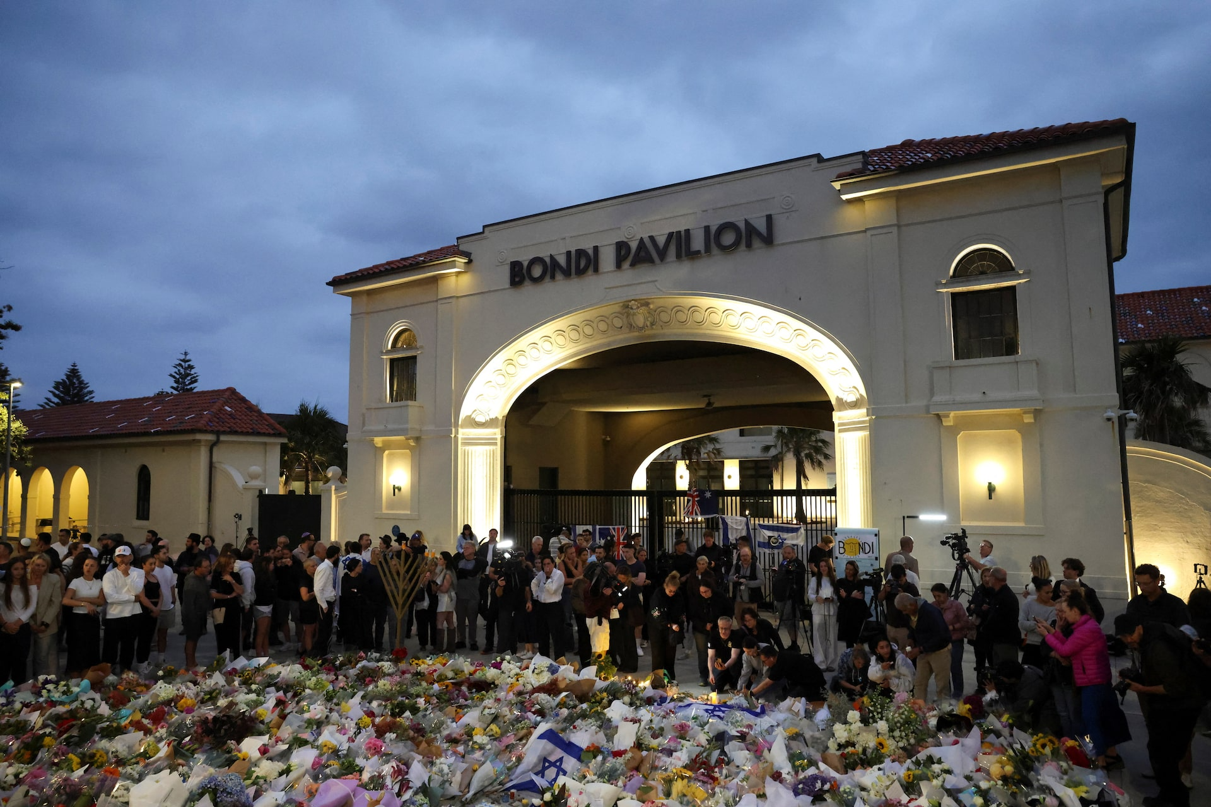

Slide 2
Psalm 80 –– a Song of Collective Lament
A bitter sadness, because it feels like God has deserted them.
Enemies have defeated them and taken Israel into captivity.
Everyone is against them and laugh at the pain they suffer.

Slide 3
Psalm 80 To the choirmaster: according to Lilies. A Testimony. Of Asaph, a Psalm.
¹ Give ear, O Shepherd of Israel,
You who lead Joseph like a flock.
You who are enthroned upon the cherubim, shine forth.
² Before Ephraim and Benjamin and Manasseh,
stir up Your might
and come to save us!
³ Restore us, O God;
let Your face shine, that we may be saved!

Slide 4
⁴ O LORD God of hosts,
how long will You be angry with Your people’s prayers?
⁵ You have fed them with the bread of tears
and given them tears to drink in full measure.
⁶ You make us an object of contention for our neighbours,
and our enemies laugh among themselves.
⁷ Restore us, O God of hosts;
let Your face shine, that we may be saved!

Slide 5
⁸ You brought a vine out of Egypt;
You drove out the nations and planted it.
⁹ You cleared the ground for it;
it took deep root and filled the land.
¹⁰ The mountains were covered with its shade,
the mighty cedars with its branches.
¹¹ It sent out its branches to the sea
and its shoots to the River.
¹² Why then have you broken down its walls,
so that all who pass along the way pluck its fruit?
¹³ The boar from the forest ravages it,
and all that move in the field feed on it.

Slide 6
¹⁴ Turn again, O God of hosts!
Look down from heaven, and see;
have regard for this vine,
¹⁵ the stock that Your right hand planted,
and for the son whom You made strong for Yourself.
¹⁶ They have burned it with fire; they have cut it down;
may they perish at the rebuke of Your face!

Slide 7
¹⁷ But let Your hand be on the Man of Your right hand,
the Son of Man whom You have made strong for Yourself!
¹⁸ Then we shall not turn back from You;
give us life, and we will call upon Your Name!
¹⁹ Restore us, O LORD God of hosts!
Let Your face shine, that we may be saved!

Slide 8
Psalm 80 –– a Song of Collective Lament
A bitter sadness, because it feels like God has deserted them.
Enemies have defeated them and taken Israel into captivity.
Everyone is against them and laugh at the pain they suffer.
Israel, surrounded by its enemies...
Want to see Israel wiped from the map.
Palestine has (for a thousand years) referred to a “region”. ( Not a country/kingdom/state )
Long before the Balfour Declaration or the modern State of Israel, it was a land given by God to His people as He freed them from slavery in Egypt.
No other people have a God-given claim to the land.
God led the people of Israel out of Egypt.
Cleared the ground for the “vine” to grow.
Extended from Lebanon to Egypt; From The Euphrates River to the Mediterranean Sea.
Because Israel were not faithful, God handed them over to their enemies.
The anguish of suffering & having everyone against them;
Knowing God has the power to save them, but recognising the suffering was His will.
¹⁷ But let Your hand be on the Man of Your right hand,
the Son of Man whom You have made strong for Yourself!
A hope for the Messiah, but they rejected Him when He came.
The Light of the World (Jesus Christ) is the Shining face of God, come to save.

Slide 9
Romans 1:1-7
¹ Paul, a servant of Christ Jesus, called to be an apostle, set apart for the gospel of God, ² which he promised beforehand through his prophets in the holy Scriptures, ³ concerning his Son, who was descended from David according to the flesh ⁴ and was declared to be the Son of God in power according to the Spirit of holiness by his resurrection from the dead, Jesus Christ our Lord, ⁵ through whom we have received grace and apostleship to bring about the obedience of faith for the sake of his name among all the nations, ⁶ including you who are called to belong to Jesus Christ,
⁷ To all those in Rome who are loved by God and called to be saints:
Grace to you and peace from God our Father and the Lord Jesus Christ.

Slide 10
Psalm 80 –– a Song of Collective Lament
A bitter sadness, because it feels like God has deserted them.
Enemies have defeated them and taken Israel into captivity.
Everyone is against them and laugh at the pain they suffer.
Israel, surrounded by its enemies...
Want to see Israel wiped from the map.
God led the people of Israel out of Egypt.
Cleared the ground for the “vine” to grow.
Extended from Lebanon to Egypt; From The Euphrates River to the Mediterranean Sea.
Because Israel were not faithful, God handed them over to their enemies.
The anguish of suffering & having everyone against them;
Knowing God has the power to save them, but recognising the suffering was His will.
¹⁷ But let Your hand be on the Man of Your right hand,
the Son of Man whom You have made strong for Yourself!
A hope for the Messiah, but they rejected Him when He came.
The Light of the World (Jesus Christ) is the Shining face of God, come to save.
Gentile believers (us) have been grafted in to the people of God.
God has not rejected the Jews. He holds His hands out to them.
We love God’s people (the Jews). We have been grafted in to them.
Praying for them to know Jesus as Saviour.
¹⁹ Restore us, O LORD God of hosts!
Let Your face shine, that we may be saved!

